Slide 1

Creative Writing 101 Machines Expressing their thoughts
100010111100011001010010010..
Tomas Suchomel
Samuel Gamer

Slide 2
Intro
Machine Learning – but how do they actually think?
Creative text is reflecting the thinking patterns
Personal main goal: Learning to implement Deep Learning
Notes:
The field of Machine Learning is kind of one single big experiment of letting machines think on their own. Instead of programming every single step of computation, instead of dictating to them what they have to think, and more importantly - how to think it, we are just giving them a task. Setting up the environment and letting them find their own way.
It's like having a child learn. you can teach it just the good words, let it grow up in a good family - but the child will have its own ideas, its own way of thinking.
So, the pictures the child will draw, the texts it writes, are a product of its mind and the patterns of its thoughts are somewhere entwined in the stories it tells.
Since Pictures are very complex, with a lot of information, they are a complicated and time-consuming way of communication. Written language however, is a lot more simple. In the English alphabet there are 26 letters, plus 26 if case-sensitive, plus some signs: ,.!?:" so around 60 characters. A big book only takes under 5 MBs of storage, which is as much as just two standard images. That is why we chose to create our project around text, not images.
Our main idea, the far goal was to get a sense of how our machine thinks. Of course, we are Beginners in the field. We started without knowledge of Ubuntu, python, let alone machine learning algorithms. So we had to define goals that were easier to achieve: Create sentences, words, letters. In hindsight all these goals are achieved with the same machine.

Slide 3
Plan
tutorial
letter-by-letter
word-by-word
word2vec
Notes:
Our first step was to find some kind of tutorial, get some example code, run it and then start to adjust it to our needs. Aside from slides of some groups of this year's DSLS course, we found the blog of xxx, who also used Keras.
xxx was training his machine on a letter-by-letter basis.
Our next idea was to train on a word-by-word basis, then later maybe divide the text in sentences.
Furthermore we found the model set Word2Vec very interesting, but since this is a machine learning task on its own, it was a far goal to use it.

Slide 4
Sources
L. Tolstoy: War and Peace – multi language
Jeff Inlo: Delver Magic
J.R.R. Tolkien: Lord of the Rings – big text body
Shakespeare – difficult theater style
Notes:
We began with War and Peace by L. Tolstoy. But since this peace contains German and French sentences, it is overly complex.
The next text was a trilogy novel we found online, Delver Magic (Jeff Inlo).
Later we used the trilogy Lord of the Rings by J.R.R. Tolkien, since we wanted a larger body of text.
We also regarded Shakespeare's texts, which seemed to complex though, for they are structured like theater instructions with only commands and direct speech.
In theory it should be possible to match the author's style doing this, but we will see that the machine's influence is quite big, too.

Slide 5
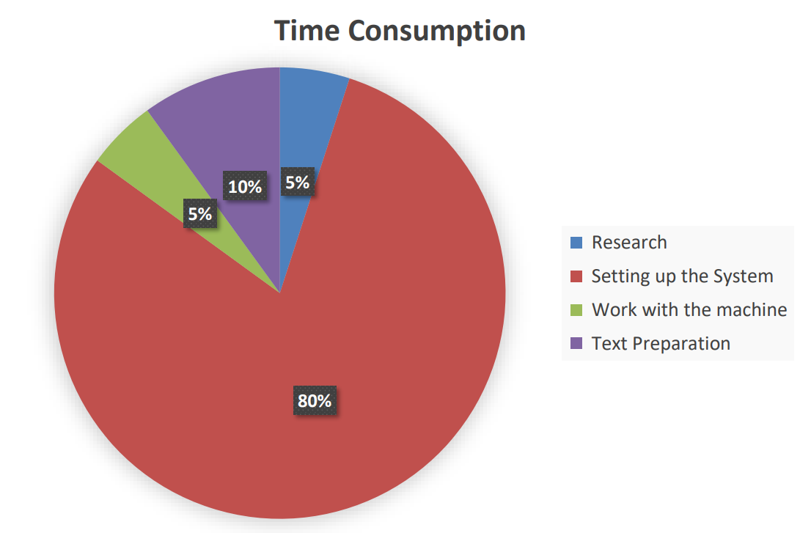
From Dream to Reality
Notes:
Our Research was quite easy. We knew we wanted to do text analysation/generation, found about five tutorials, read three of them, decided for one.
The Text Preparation for the first type, letter-by-letter was not overly difficult. We had to take care of semicolons and multiple full stops, delete a few errors in the text. The word-by-word variant took a lot more time, because we had to create our own dictionary word - to - number and execute it.
But Setting up the System was a nearly impossible task for us:

Slide 6
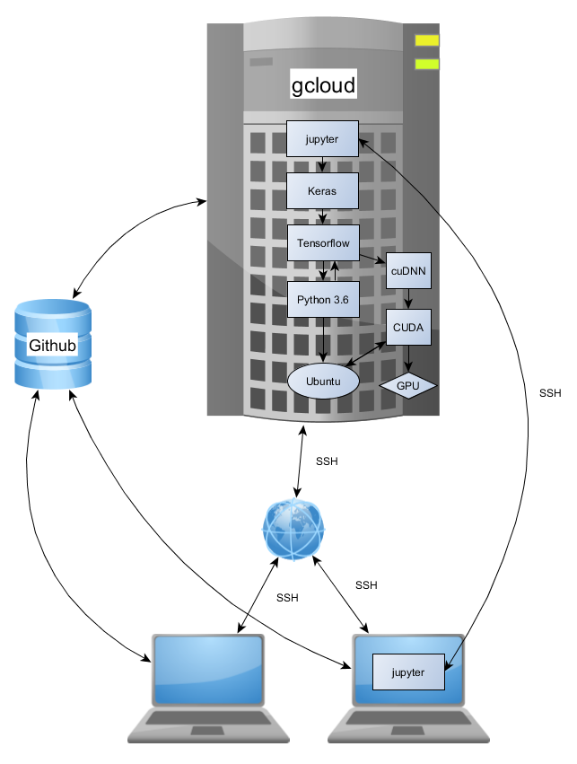
System Setup
Notes:
We have the main system.. running on a gCloud instance, which is accessed and installed only via SSH. To do heavy computation, we need the GPU, and everything has to be in the right versions, in order to work together. Downwards compatibility is not usually given. And of course we are working on the machine together, and for ease of use and a little bit of GUI, we need Jupyter. Then we need to get our data on the cloud, which is easiest via Github.

Slide 7
Model
Standards for Text Generation: RNN, LSTM, GRU
RNN has too short memory (vanishing Gradiant)
Beginning with LSTM (tutorial)
Next step: GRU

Slide 8
Model : Deep LSTM
Dense Layer: Time Distributed
LSTM: capacity=500
Output
Activation
(Softmax)
σ
Dense layer
t
2 LSTM
layers
Input

Slide 9
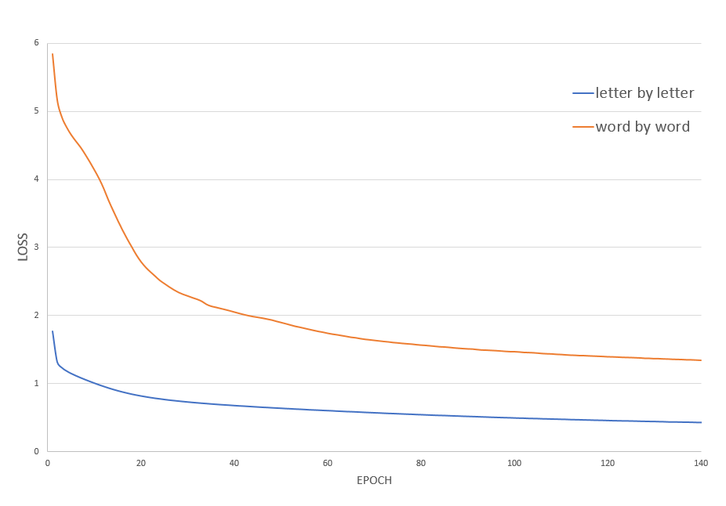
Results: Losses

Slide 10
Results: The Lord of the Rings
input text = 2 470 966 chars
 | letter-by-letter | word-by-word
Input length | 2 466 606 | 228 165
vocabulary size | 60 | 6 832
Sequence length | 50 | 10
Number of sequences | 49 420 | 22 817
Notes:
Word-by-word: words with occurrence 1 renamed as unknown

Slide 11
Results: Sentences
Epoch 5:
Words: ..Grows ' of , unknown to , enemy the and and in am not know ' and unknown Frodo and unknown..
Letters: ..xing to the walls of the City, and the strangers were still the strangers and the strangers and the water and the walls of the East and the walls of the East..

Slide 12
Results: Sentences
Epoch 10:
Words: ..Gather the and and in will ' and unknown frodo the and in am sorry ' and unknown but have come a , way the and and in am sorry a the and of in they too rohan a..
Letters: ..? ' said Frodo. 'But I cannot see them and the strength of the house of Elendil and Isildur's Bane. I have not seen the next move. He wondered what he was of the words of the Shire and the sound of the stream that was still to be seen. The sun was shining in the sunlight of steel..

Slide 13
Results: Sentences
Epoch 40:
Words: ..Burst it stars to blue of green ' or after full are ever and and i ? The and and unknown we unknown unknown the , road we now ? Yet do but with would name ? ? ?..
Letters: ..Now Sam stirred. 'Well, well! may you leave him already.' He pained his eyes and struggled on the rim of the strange light of the mountain-side when the hearth will of the Entwash. The Shire was greater and stronger. For the moment more to the world..

Slide 14
Results: Sentences
Epoch 140:
Words: ..Backward , first unknown their shire the tell them ' was may be right south sod unknown our unknown gandalf gimli very gandalf..
Letters: ..'Yes, we'll go soon,' said Frodo, as he draided his long lists, all about the shadows of the grey trees, save for a fleeting man in Hobbiton and King Elendil are west of the Shire, and the rest may break out for them in the northern arcover..

Slide 15
Conclusion
We could clearly see how the machines learn and understand the structure of language
Encoding words as simple integers seems to stripe them from inner context
Does maybe mother, father, brother have inner structure the machine understands?
Are children learning the same way?

Slide 16
Prospect/Perspective
Using word2vec to keep word contexts
Compare LSTM w/ GRU

Slide 17
Sources
https://chunml.github.io/ChunML.github.io/project/Creating-Text-Generator-Using-Recurrent-Neural-Network : tutorial
http://papers.nips.cc/paper/5166-training-and-analysing-deep-recurrent-neural-networks.pdf : DLSTM proposition(3layer)
https://diplernin.github.io/ : Inspiration : DLSL group last year

Slide 18
Thanks for your Attention
Questions?
Tomas Suchomel
Samuel Gamer

